Slide 1
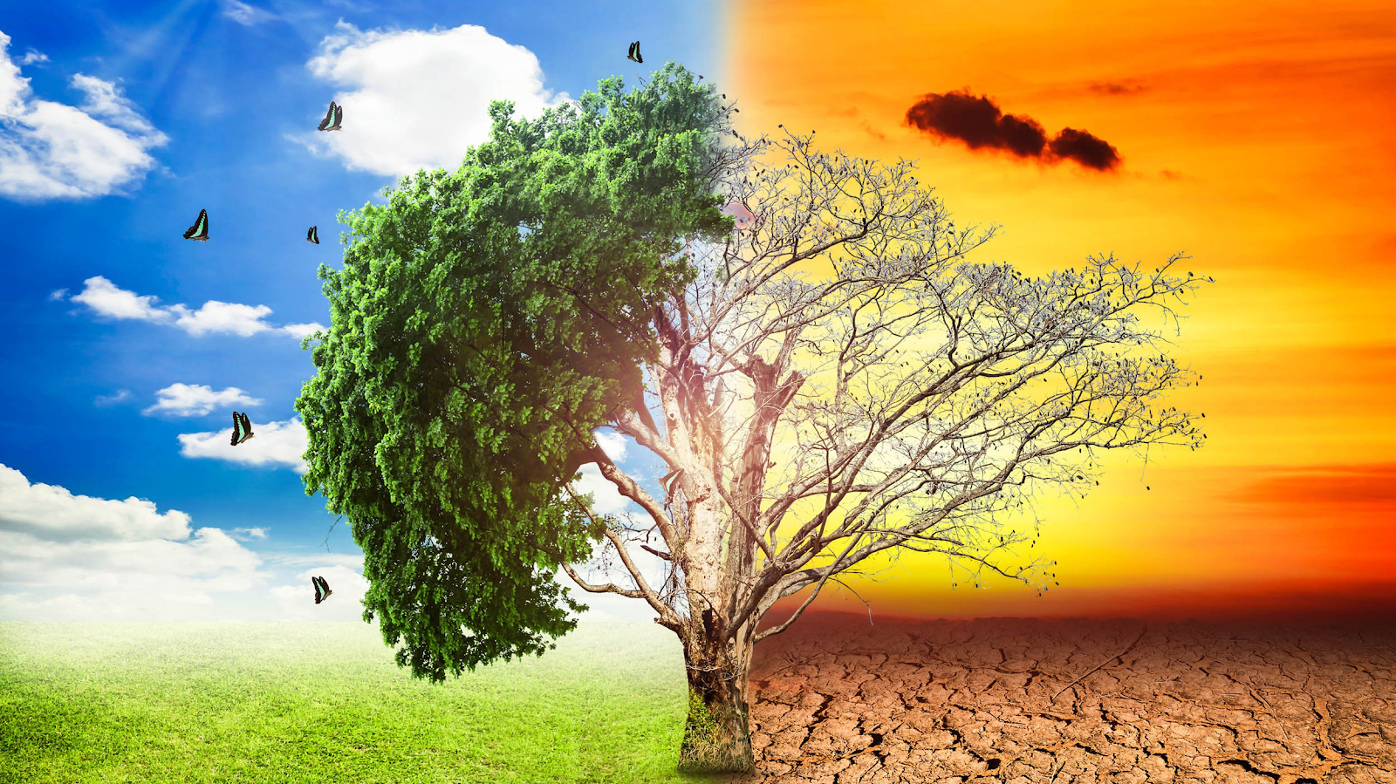
Causes of Climate Changes

Slide 2
Presented By
Akhil Mathew
Neenu Markose

Slide 3

Climate & Weather
Weather:
Short-term atmospheric conditions.
Limited Area
It can change rapidly.
Climate:
Average of weather over time & space.
Long term/Seasonal change.
Wide Area

Slide 4
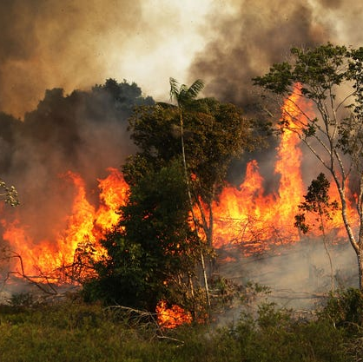
Wildfire
Climate change brings drought & increase in temperature which makes it easy for wildfire.
Human Causes

Slide 5
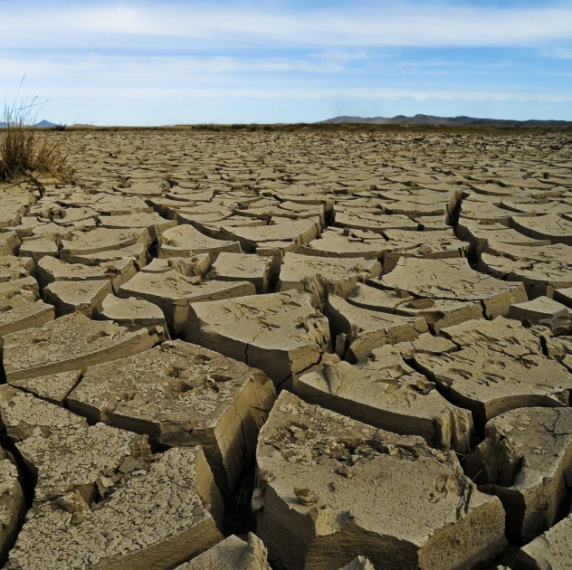
Drought
Warmer temperature enhances the water evaporation and causes drought.
Long-term impacts- land subsidence, seawater intrusion.
This Photo by Unknown Author is licensed under CC BY-NC

Slide 6
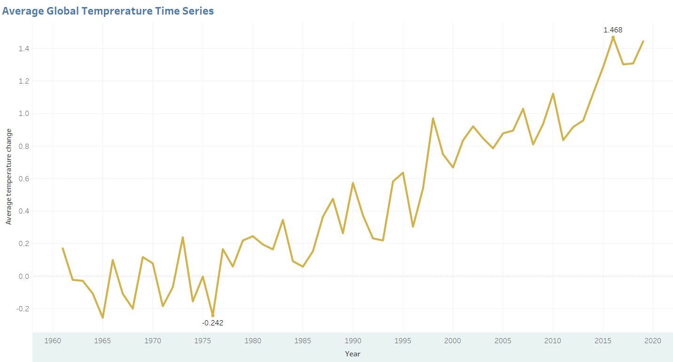
Temperature Rise
Graph shows the variation of temperature over the years.
What could be the possible reasons???

Slide 7
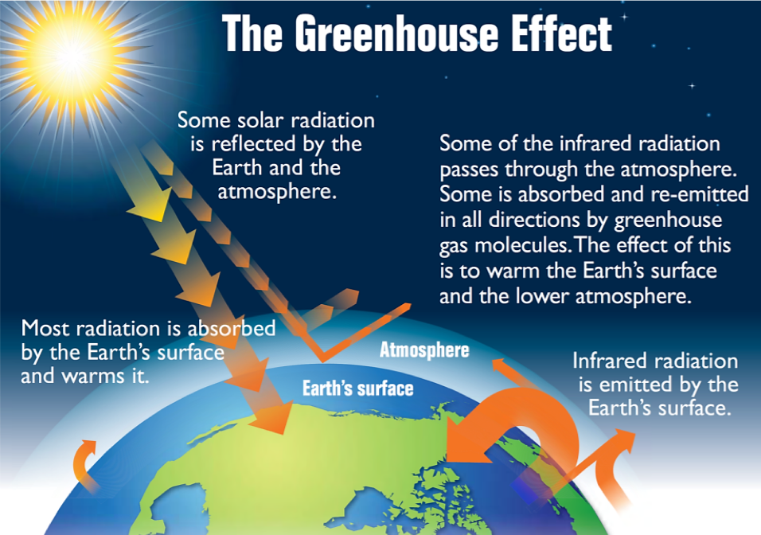
Greenhouse Gases
Trap the heat that would otherwise escape from the atmosphere.
Six main Greenhouse gases:
Water vapor
Carbon dioxide
Methane
Nitrous oxide
Ozone
Synthetic greenhouse gases

Slide 8
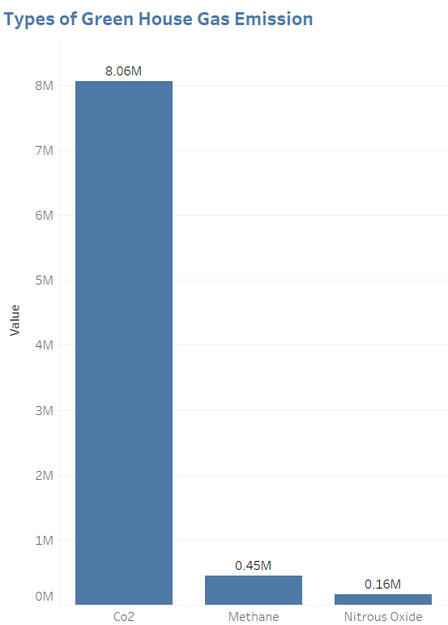
Reason for Climate Change
Excessive emission of Greenhouse gases
CO2 is the primary Greenhouse gas that makes an impact on climate.

Slide 9
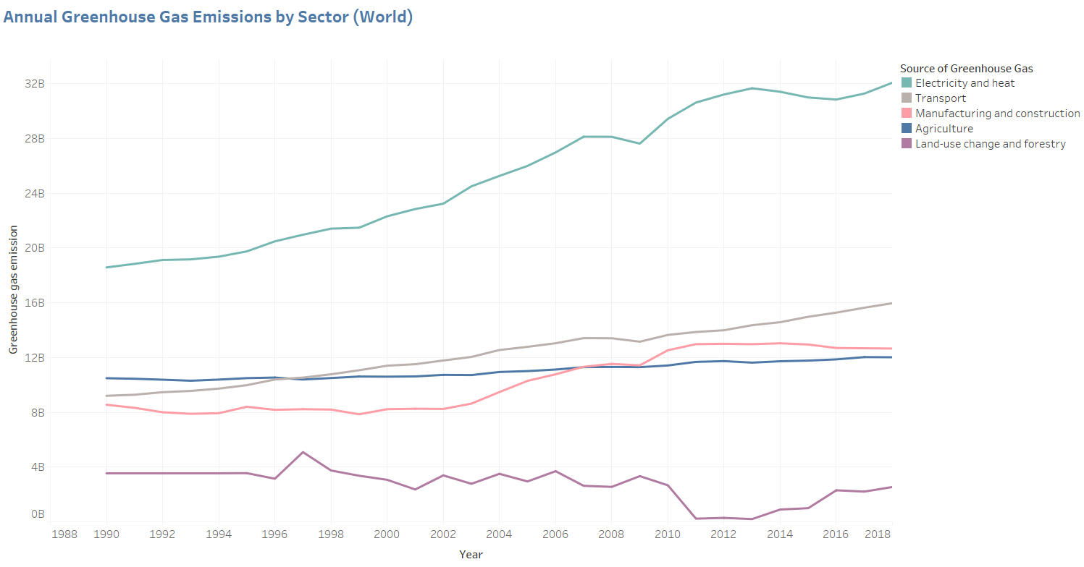
Source of Greenhouse Gases
Different sources facilitate the emission of greenhouse gases in the atmosphere.
Electricity & Heat is the major source.

Slide 10
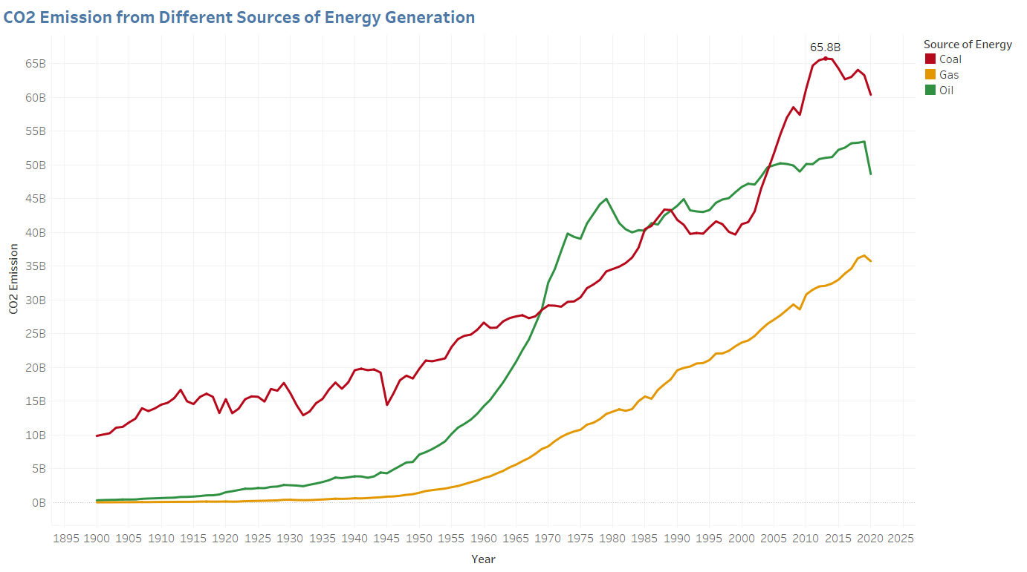
CO2 emissions from different sources of Electricity Production

Slide 11
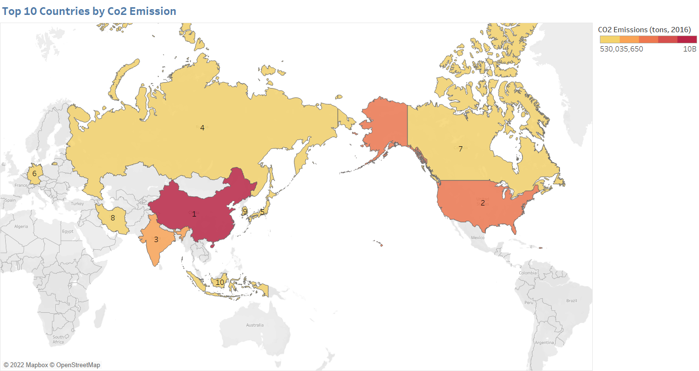
Top 10 Countries by CO2 Emission

Slide 12
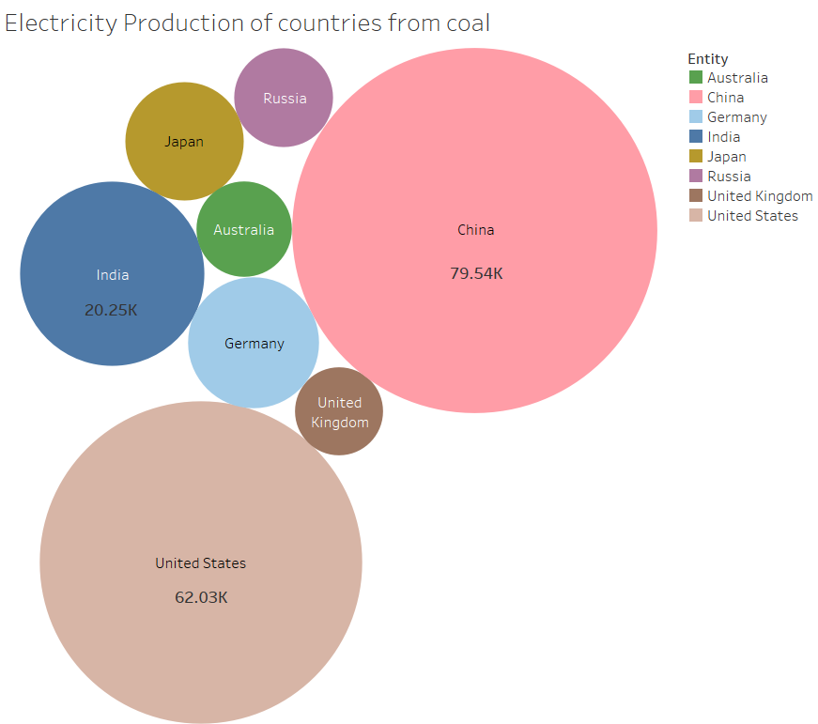
Electricity Production of Countries from Coal

Slide 13
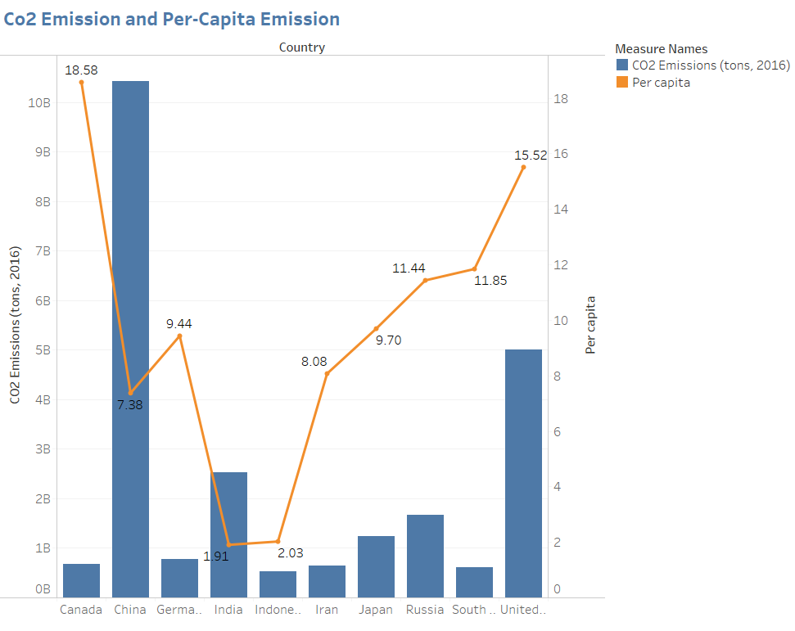
CO2 Emission & Per Capita

Slide 14
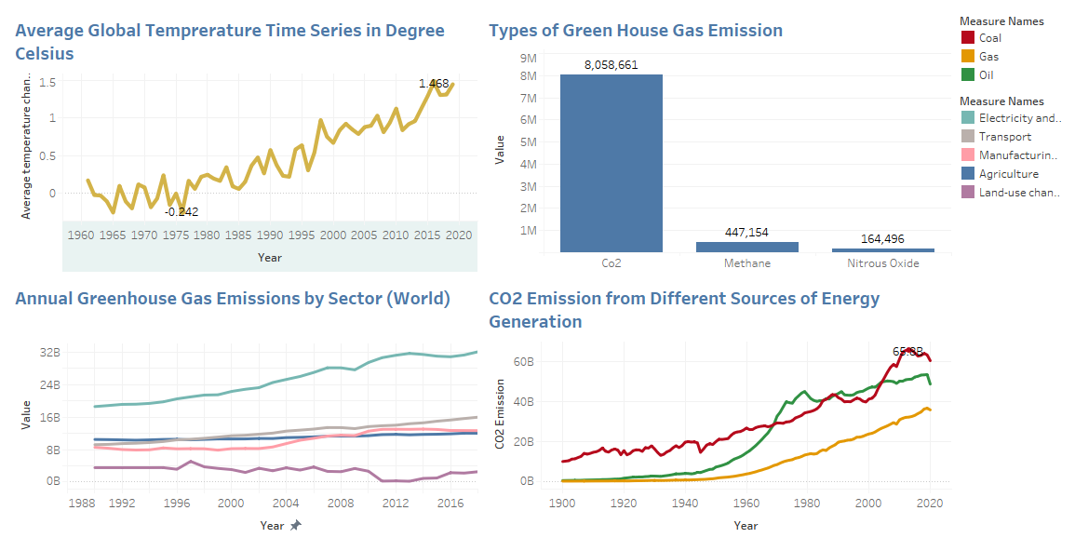
Dashboard 1

Slide 15
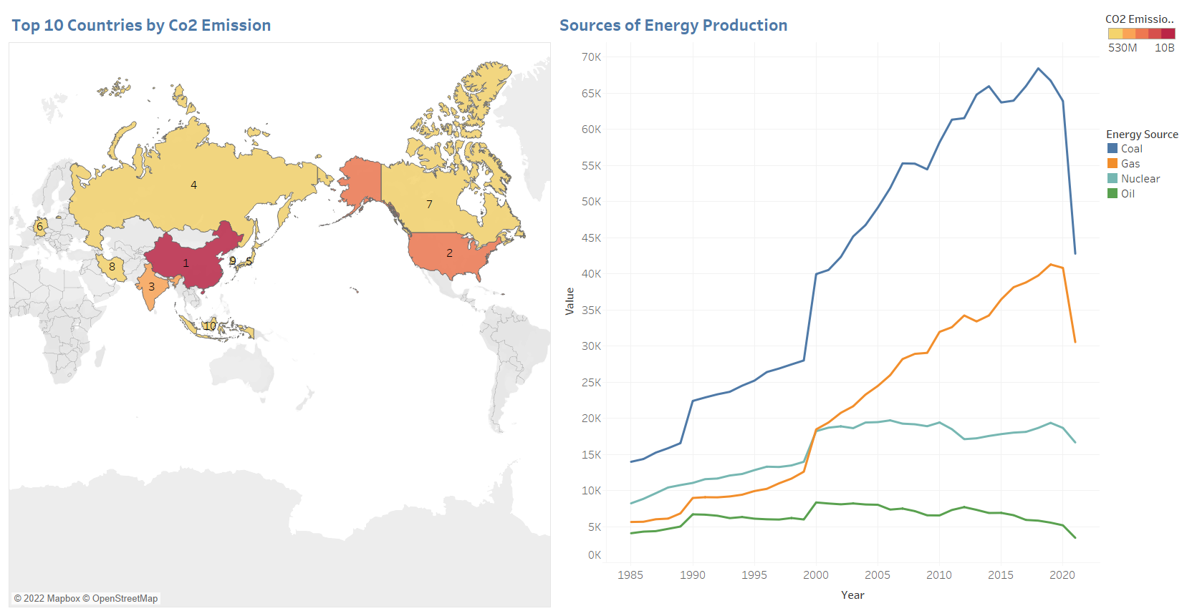
Dashboard 2

Slide 16
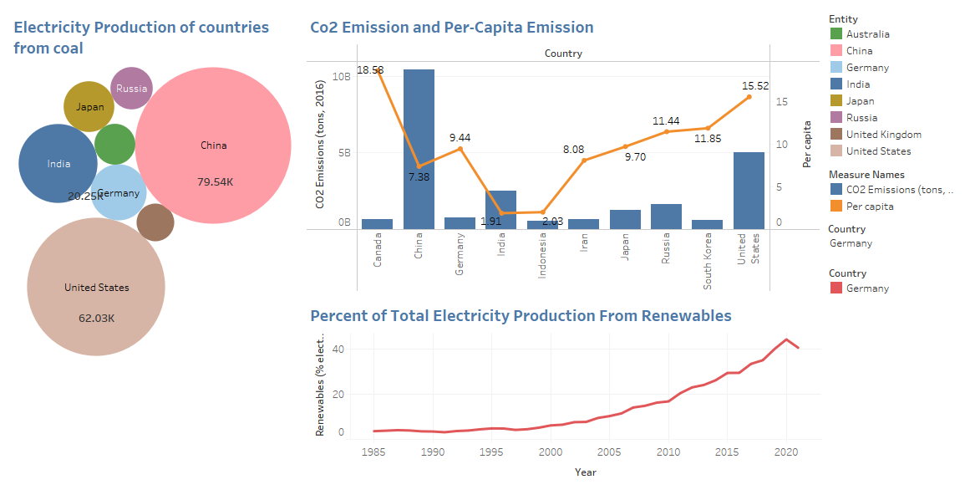
Dashboard 3

Slide 17
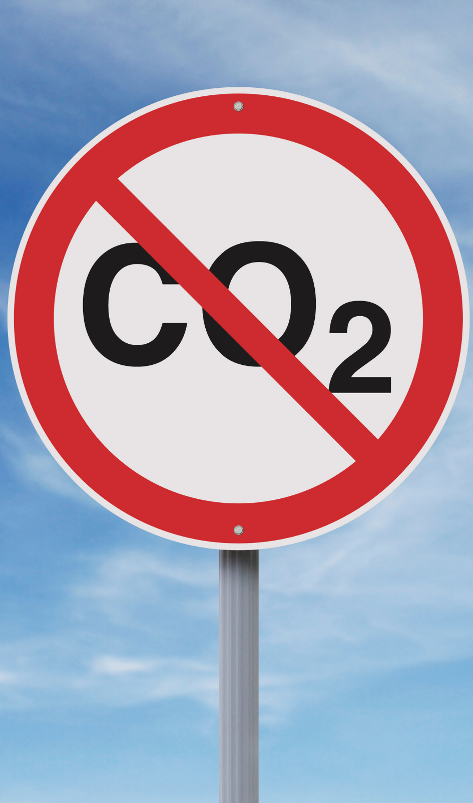
Net-zero Emission
No over-releasing greenhouse gases into the atmosphere.
Removing an equal amount of Greenhouse gases to compensate for emissions.
Strategies:
Electricity without emission
Electric vehicles
Use energy efficiently
Remove Carbon dioxide from the atmosphere.

Slide 18
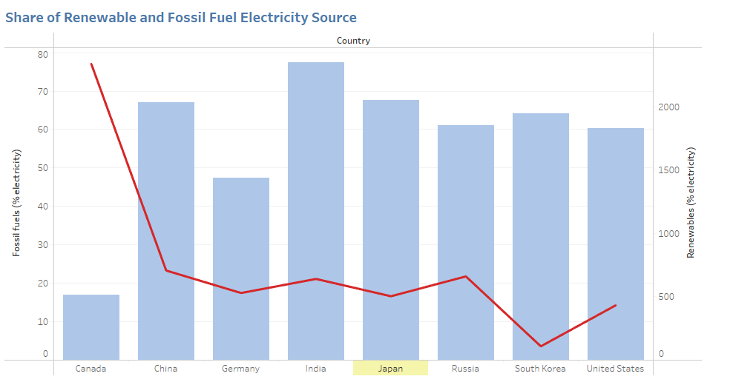
Electricity Generation by Renewables

Slide 19
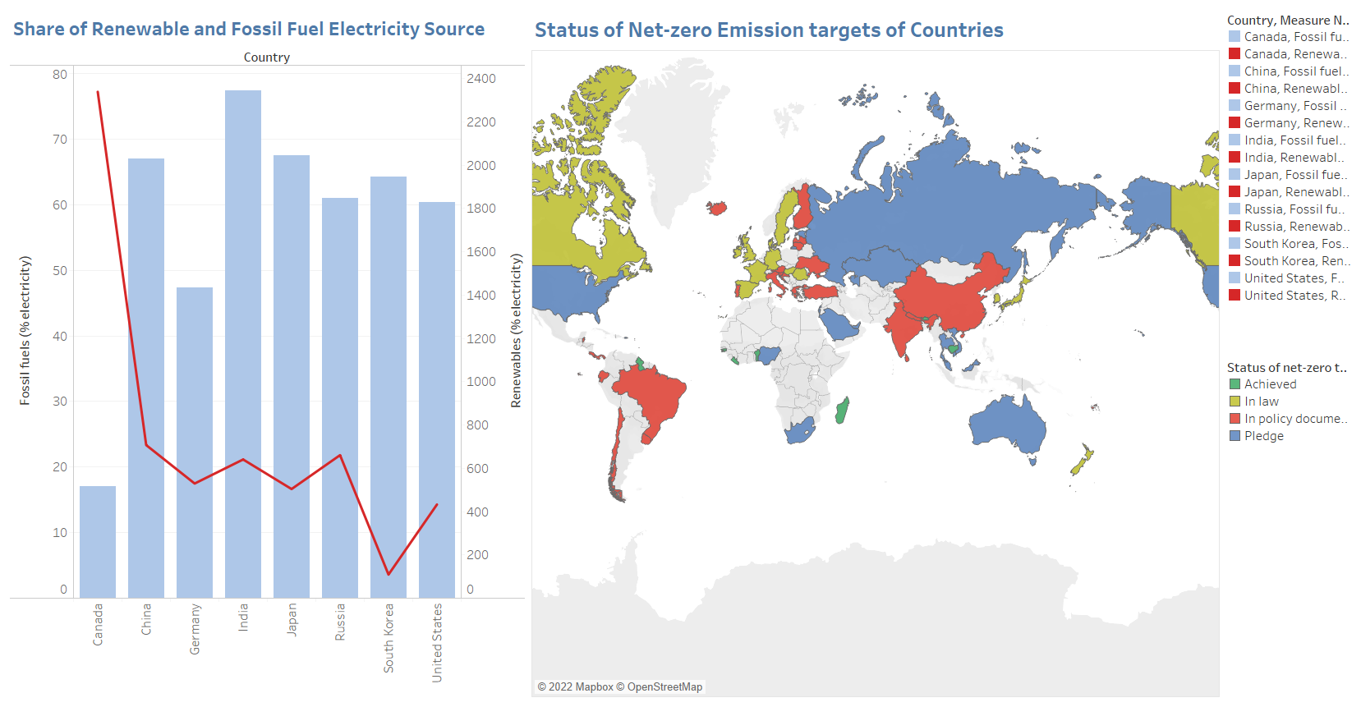
Net-zero Emission

Slide 20

Thank You

